Slide 1
Chapter 5 do...while loop

Slide 2
do...while loop
The do….while loop is similar to the while loop with one important difference. The body of do...while loop is executed once, before checking the test expression. Hence, the do...while loop is executed at least once.

Slide 3
do...while loop Syntax
do
{
// codes
}
while (testExpression);

Slide 4
How do...while loop works?
The code block (loop body) inside the braces is executed once.
Then, the test expression is evaluated. If the test expression is true, the loop body is executed again. This process goes on until the test expression is evaluated to 0 (false).
When the test expression is false (nonzero), the do...while loop is terminated.

Slide 5
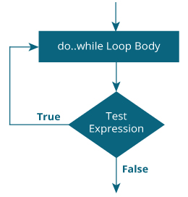
Flowchart of do...while Loop

Slide 6
Example 2: do...while loop
// Program to add numbers until user enters zero
#include <stdio.h>
int main()
{
double number, sum = 0;
// body of loop is executed at least once
do
{
printf("Enter a number: ");
scanf("%lf", &number);
sum += number;
}
while(number != 0.0);
printf("Sum = %.2lf",sum);
return 0;
}

